Slide 1


CUSTOMER ADOPTION
IN B2B ECOMMERCE

Slide 2
Upcoming
YES! We are recording
Questions in the chat
B2B BootCamp: onboard new employees, upskill existing ones
B2B eCommerce Association Show - podcast / youtube channel
Chicago: October 03, Customer Adoption Live event
October 17: How to select a B2B eCommerce Platform
November: Shark Tank

Slide 3
75%
92%
67%

Slide 4

Companies with a Digital Strategy see:
79% Increase in awareness of new products
74% Increase in cost efficiencies
64% Improvement in customer retention
58% Additional margin per customer
48% Growth of revenue per customer

Slide 5



“I struggle to get support from my exec teams.”
“I struggle to communicate with my digital teams.”

Slide 6

Common Problems We Hear
“How do we drive more revenue through eCommerce?”
Execs: “I struggle to communicate with my digital teams.”
Digital leaders: “I struggle to get support from my exec teams.”
“How do we make eCommerce strategic?”

Slide 7
How do we drive more revenue through eCommerce?

Slide 8

Hope is not a Strategy
Notes:
There is no build it and they will come
You have to have a plan that you are striving towards

Slide 9


Slide 10

ADOPTION or ACQUISITION?
Notes:
To start your plan – you have a critical question to answer.
Over the next 24 months, Are you building your DigitalBranch to acquire new customers or is it for your existing customers to use and adopt
Acquisition versus Adoption in other words.
I know you want both, but the best distributors are hyper focused on one or the other.

Slide 11




Customer Acquisition Framework
TRAFFIC
CONVERSION
AOV
CUSTOMER
LOYALTY
Notes:
If you choose Acquisitions, This is an example of a B2C or Customer Acquisition Framework

Slide 12
How do I get my customers to
USE
my digital tools?

Slide 13
Customer Adoption Framework
Simple to understand (and teach)
Executive can get on board
Builds a common language
And… you can manage your business with it

Slide 14
Customer Adoption Framework
CUSTOMER
An existing customer that has purchase in the past
Username and password
ONBOARDING
ENGAGE & DISCOVER
Research product, price and availability
Places very first online order
BUY & TRY
REPEAT & REWARD
Orders and researches regularly
Notes:
In B2B, though – most of the time we start by focusing on Customer Adoption.
There are 5 steps in the Framework and like the Acquisition framework it can be used to describe a financial model as well.
I am not going to spend time walking through this framework, but it is an incredible framework to use for B2B.

Slide 15

CUSTOMER
ONBOARDING
The magic happens here!
ENGAGE & DISCOVER
BUY & TRY
REPEAT & REWARD
Notes:
In B2B, though – most of the time we start by focusing on Customer Adoption.
There are 5 steps in the Framework and like the Acquisition framework it can be used to describe a financial model as well.
I am not going to spend time walking through this framework, but it is an incredible framework to use for B2B.

Slide 16

No Adoption??

Slide 17
No Adoption??
They don't know about it
They don't trust it
They don't understand it
They will never use it

Slide 18

Who is the most important person in your organization?
Notes:
Who do you think is the most important person in your organization when it comes to your ecommerce project?
Many will say, VP of IT, VP of Marketing, the CEO or the head of eCommerce.
However, the most important person in your eCommerce project is your head of sales and frankly your entire Sales team.
Nothing will kill an eCommerce or Digital project faster than a sales person who tells their customer to research on the website, but buy from them because they will get them a cheaper price.
This of course brings up a lot of other issues like centralized pricing, but ignoring that for a moment – you have to align your organization with your new initiative.
That includes aligning incentives and compensation with your new channel. Your sales people are coin operated – and go where the money is.

Slide 19
Getting Customers Registered
Market internally
Get internal adoption
Partner with Sales
Incentivize your sales team
Simplify the registration process

Slide 20
3 Keys to Onboard → Engage & Discover
Search
Search
Search

Slide 21
1
2
search
action
CONTENT
3
4
tools
consistent

Slide 22
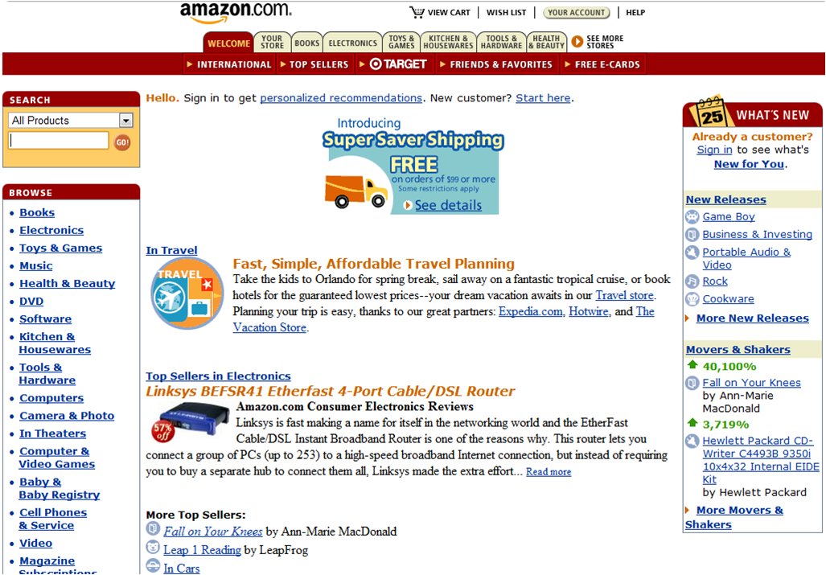

Slide 23
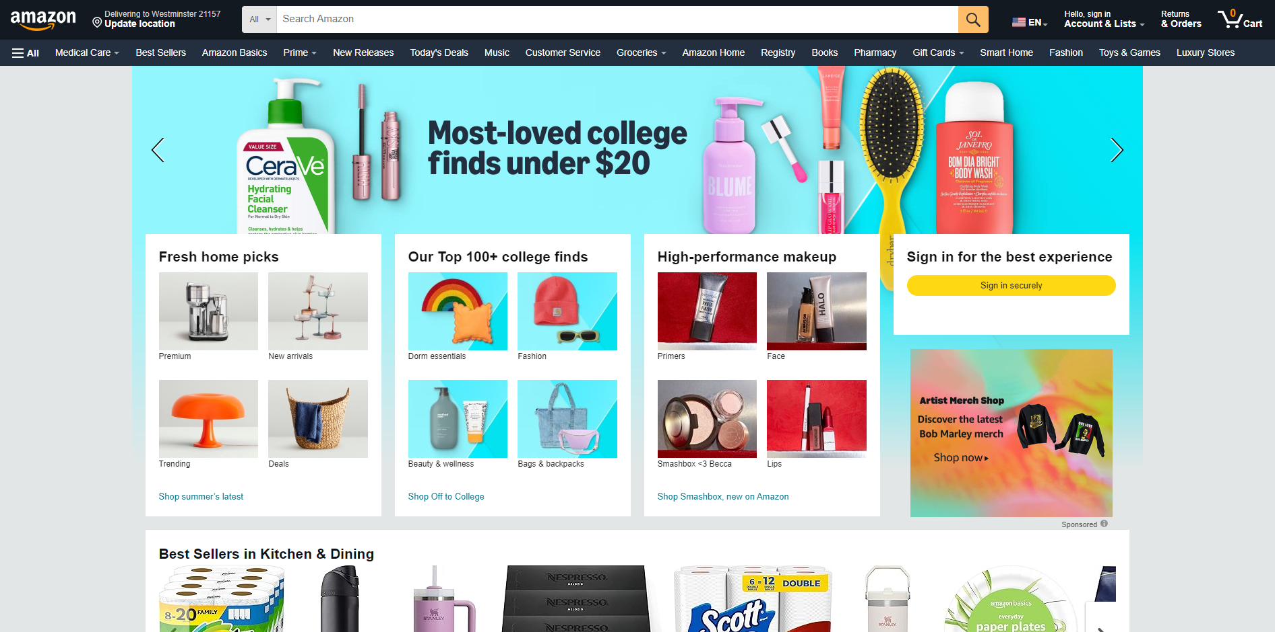

Slide 24
Search Tactic
Use a digital shelf analytics tool or…
Monthly, export the top 100 onsite searches for the prior month
Have a business analyst perform each search and review the results page
  Are the search engine results applicable to the search term?
  For exact matches on indexed attribute searches, is the product page the 1st result?
  Should the search term forward to a category page?
  Should a synonym be setup to match a different non-indexed attribute like street name or MPN or SKU?
  Are there results listed that do not apply to the term and should be buried?

Slide 25
Product Content and Search
are Programs not Projects

Slide 26
Questions customer is trying to answer
Is this the right product to solve my problem?
Do you have it?
What’s my price?
When can I get it?

Slide 27
Engage 🡪 Buy & Try
Search
Simple and Intuitive Registration
Customer Incentives
Loyalty Programs
Internal Evangelism – Sales Incentives

Slide 28
Buy 🡪 Repeat & Reward
Don’t screw up the first order!
The “Perfect Order” hint: doesn’t stop at purchase (fulfillment)
Amazon → Click the button and it shows up
Create a journey map. How do you exceed expectations of your customers?

Slide 29
Brainstorm
Create sessions for each stage
Invite cross-functional teams
Side benefit: you are subtly marketing the framework
More, Better, New framework for prioritizing
  Easier to do more of the same, than better
  Easier to do better than new
Use a facilitator for your first time! 3rd party can help educate your team about the framework and methodology

Slide 30
Monthly Meeting with Executive Teams
CUSTOMER
Report monthly to your executive team showing month over month changes and eventually year over year.
# Registrations
# Sessions
# First Orders / $$
# Repeat Orders
$ AOV
$ Revenue
ONBOARDING
ENGAGE & DISCOVER
BUY & TRY
REPEAT & REWARD
Notes:
In B2B, though – most of the time we start by focusing on Customer Adoption.
There are 5 steps in the Framework and like the Acquisition framework it can be used to describe a financial model as well.
I am not going to spend time walking through this framework, but it is an incredible framework to use for B2B.

Slide 31
Upcoming
B2B BootCamp: onboard new employees, upskill existing ones
Chicago: October 03, Customer Adoption Live event
October 17: How to select a B2B eCommerce Platform
November: Shark Tank

Slide 32
Common Problems
“How do we drive more revenue through eCommerce?”
Break the problem down with a framework
Include cross-functional teams to brainstorm
Execs: “I struggle to communicate with my digital teams.”
Create a common language to talk about digital
Digital leaders: “I struggle to get support from my exec teams.”
Change takes time. Discuss results (KPIs) monthly.

Slide 33



